Slide 1
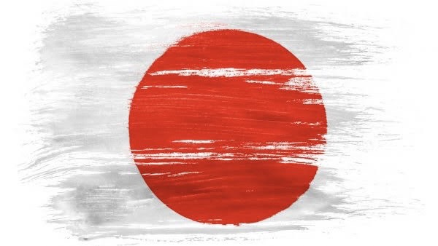

Japan
and
Germany
Presentation by Kotone Hayashi

Slide 2
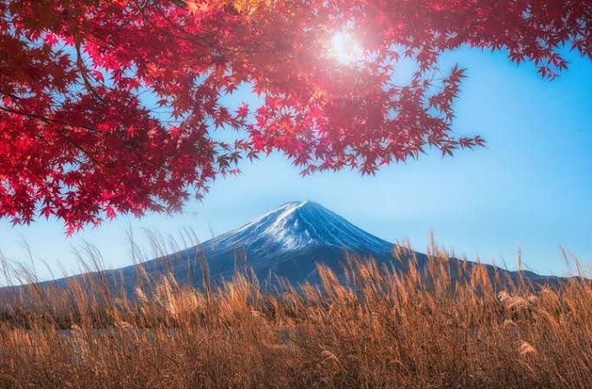
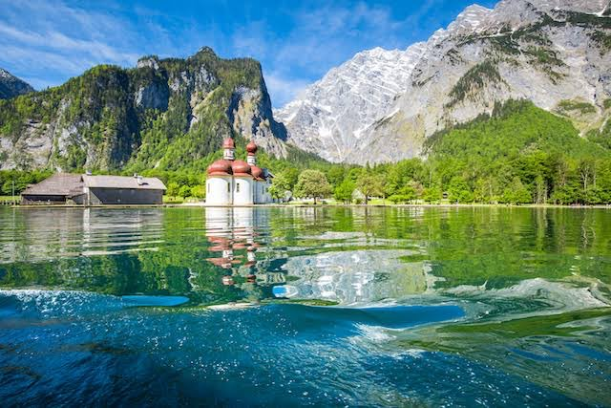
Both are …
rich in nature

Slide 3


delicious food

Slide 4
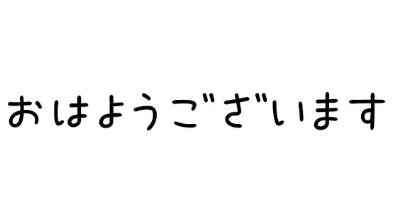

Official language

Slide 5


Population
Japan
and
Germany

Slide 6
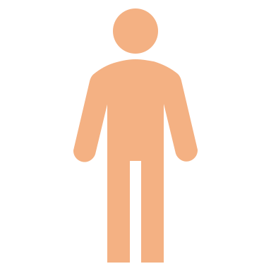


Population
🇯🇵
128 million
🇩🇪
83 million

Slide 7
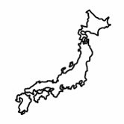
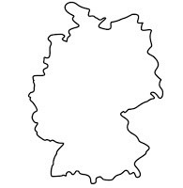
Area
Which one has the larger area?
Japan
and
Germany

Slide 8
🇯🇵
🇩🇪
378,000
357,000

Slide 9
Population density
Converting these to population density ...

Slide 10
🇯🇵
340
🇩🇪
230

Slide 11

Medical care
Medical care is very advanced in Japan and Germany.
But the number of doctors is quite different.

Slide 12
But the number of doctors is quite different.
Which country is more?

Slide 13
🇩🇪
4.3
🇯🇵
2.4

Slide 14
Population
Area & Population density
Medical care
🇯🇵＞🇩🇪
🇯🇵＞🇩🇪
🇯🇵＜🇩🇪

Slide 15
Why is there such a difference in the number of doctors?

